Slide 1
Stratospheric Ozone

Slide 2
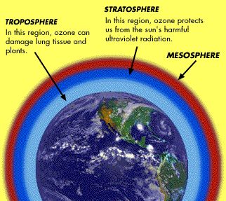
Ozone in the atmosphere

Slide 3
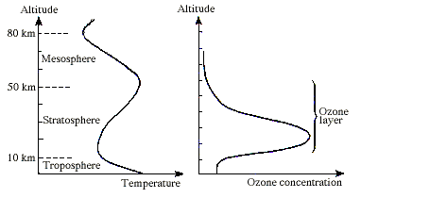
The ozone layer

Slide 4
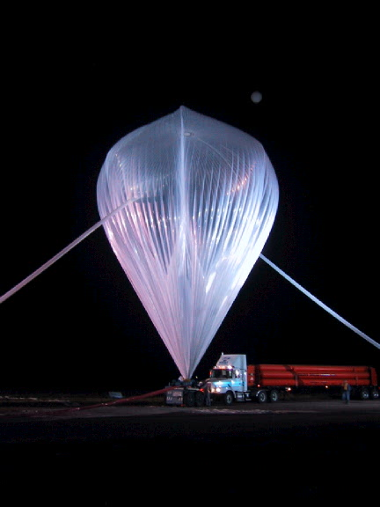
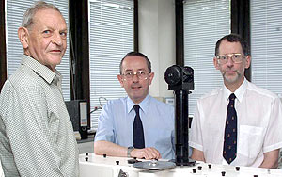
The Discovery of ozone hole
In 1985, using satellites, balloons, and surface stations, a team of researchers had discovered a balding patch of ozone in the upper stratosphere, the size of the United States, over Antarctica.
Team who discovered the hole 1985.
From left: Joe Farman, Brian Gardiner, and Jonathan Shanklin

Slide 5
Total Ozone Mapping Spectrometer (TOMS)
Used by NASA to measure ozone concentrations
TOMS – a satellite-borne instrument

Slide 6
Express ozone abundance
Total column ozone is the total amount of ozone present from the surface to the top of the atmosphere.
Dobson Units (DU) is used to express the total column ozone, named after G.M.B. Dobson, a scientist who conducted pioneering measurements of the stratosphere in the 1920s and 1930s.
One DU is the thickness, measured in units of hundredths of a millimeter (0.01 mm), that the ozone column would occupy at standard temperature and pressure (273 K and 1 atm):
1 DU= 2.69x10¹⁶ ozone molecules per cm³

Slide 7
Typical ozone column values
Total ozone column value ranges from 290 to 310 DU over the globe.
If all the atmosphere's ozone were brought down to the earth's surface at standard pressure and temperature, it would produce a layer of about 3mm thick.

Slide 8
What causes the depletion?
Ozone depletion: when sum of ozone over height is lower than 200 DU, we say "ozone depletion" occurs.
release of manmade chemicals –
CFC - refrigerants, aerosol sprays, solvents and foam-blowing agents
halogen compounds - Fire fighters used bromine-containing halogens to put out fires
NO_{x}

Slide 9
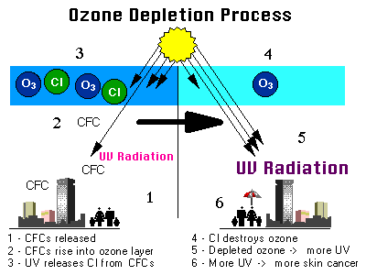
One chlorine atom - average - destroys one thousand ozone molecules before converted into form harmless to ozone
Notes:
It is now accepted that chlorine and bromine compounds in the atmosphere cause the ozone depletion observed in the `ozone hole' over Antarctica and over the North Pole. However, the relative importance of chlorine and bromine for ozone destruction in different regions of the atmosphere has not yet been clearly explained. Nearly all of the chlorine, and half of the bromine in the stratosphere, where most of the depletion has been observed, comes from human activities.

Slide 10
“Chapman Reactions”
Ozone is formed by:
O₂ + hv -> O + O
(1)
Ozone can reform resulting in no net loss of ozone:
O₃ + hv -> O₂ + O
(2)
O + O₂ -> O₃
(3)
Ozone is also destroyed by the following reaction:
O + O₃ -> O₂ + O₂
(4)
Chapman theory describes how sunlight converts the various forms of oxygen from one to another, explains why the highest content of ozone occur in the layer between 15 and 50 km, termed the ozone layer
Notes:
It is created when ultraviolet radiation (sunlight) strikes the stratosphere,
dissociating (or "splitting") oxygen molecules (O2) to atomic oxygen (O). The atomic oxygen quickly combines with further oxygen molecules to form ozone:
O2 + hv -> O + O (1)
O + O2 -> O3
(2)
(1/v = wavelength < ~ 240 nm)
The reactions above, labelled (1)-(4) are known as the "Chapman reactions". Reaction (2) becomes slower with increasing altitude while reaction (3) becomes faster. The concentration of ozone is a balance between these competing reactions. In the upper atmosphere, atomic oxygen dominates where UV levels are high. Moving down through the stratosphere, the air gets denser, UV absorption increases and ozone levels peak at roughly 20km. As we move closer to the ground, UV levels decrease and ozone levels decrease. The layer of ozone formed in the stratosphere by these reactions is sometimes called the 'Chapman layer'.
But there was a problem with the Chapman theory. In the 1960s it was realised that the loss of ozone given by reaction (4) was too slow. It could not remove enough ozone to give the values seen in the real atmosphere. There had to be other reactions, faster reactions that were controlling the ozone concentations in the stratosphere.
So called after S. Chapman who is famous for his paper 'A theory of upper-atmosphere ozone, Mem. Roy. Meteorol. Soc.' in 1930 which set out the first theoretical explanation of the ozone layer in the stratosphere.

Slide 11
Comparison of reactions
Reaction (2) slower with increasing altitude
Reaction (3) faster with increasing altitude
Lower in stratosphere, atmosphere denser, UV absorption increases – ozone peaks 20km
Closer to surface, UV level decr, ozone decr

Slide 12
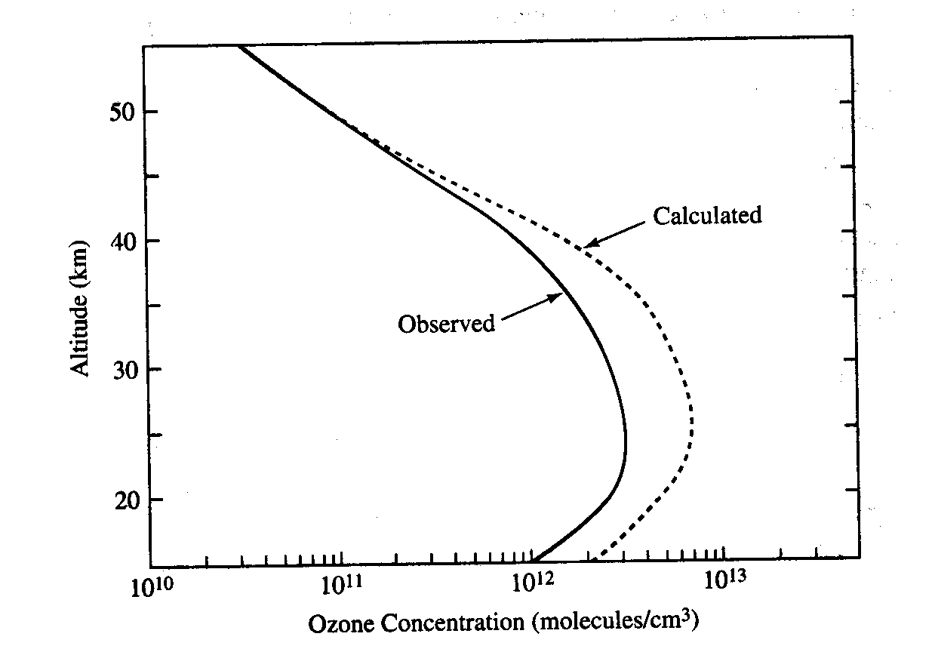
Prediction by Chapman theory vs. Observation
Using Chapman theory
Notes:
Chapman theory gives an ozone vertical profile of the same shape as the observed data, but predicts the O3 values a factor or two too high.

Slide 13
The important catalysts for stratospheric O3 destruction
Hydroxy radical (OH)
  .OH + O3 = HO2. + O2
  HO2. + O = .OH + O2
  Net: O + O3 = 2 O2
Chlorine and bromine (Cl and Br)
  Cl. + O3 = ClO. + O2
  ClO. + O = Cl. + O2
  Net: O + O3 = 2 O2
Nitric oxide (NO)
  NO + O3 = NO2 + O2
  NO2 + O = NO + O2
  Net: O + O3 = 2 O2
HOx cycle
ClOx cycle
NOx cycle

Slide 14
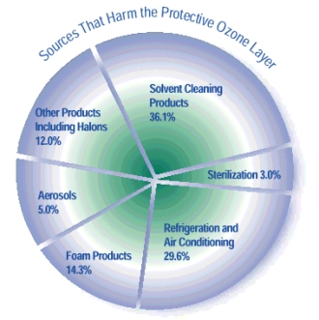
Sources that harm ozone layer

Slide 15
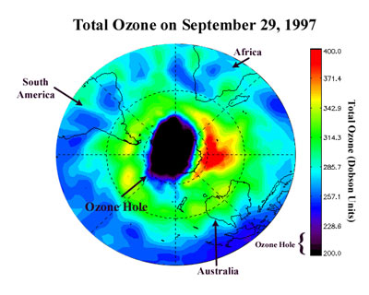
A combination of low temperatures and elevated chlorine and bromine concentrations are responsible for the destruction of ozone in the upper stratosphere thus forming a “hole”. (Kerr, 1987)

Slide 16
Polar ClOx cycle to remove O3
Polar regions: lack of O atom because of low sun elevation→ The ordinary ClOx cycle is not operative since it requires the presence of O atom.
Under polar atmospheric conditions, the reaction sequence to remove O3 is as follows
Cl + O3 →ClO + O2
ClO + ClO → ClO-OCl
ClO-OCl + hv→ ClOO + Cl
ClOO + hv → Cl + O2
2 [Cl + O3 → ClO + O2]
Net of the last FOUR reactions: 2O3 + hv → 3O2

Slide 17
CFC substitutes
The main strategy has been to explore the suitability of hydrochlorofluorocarbons
  The Cl and/or F substituents lend HCFCs some of the desirable properties of CFCs (e.g. low reactivity, fire suppression, good insulating and solvent characteristics, boiling point suitable for use in refrigerator cycles)
  The presence of C-H bond reduces the tropospheric lifetime significantly
HCFCs are only transitional CFC substitutes

